Slide 1
Marianna Zhang
The effect of formal explanations on kindhood and essentialism
aka Noyes & Keil, 2019 study 1 for formal explanations
Markman lab meeting
2.20.20
Notes:
Walk through some recent developments in the world of generics and essentialism, think about how it translates to my FYP on formal explanations and essentialism, and what study to do next

Slide 2
Structural context
Generic language
“Dogs bark.”
What do generics tell us?
Essentialism
category is a natural kind and possesses an internal essence that causally produces properties
category is situated in a stable external context (a structural context) that causally produces properties
Noyes & Keil, 2019
Notes:
What kinds of language might cue children to essentialize a category?
Generic language – describe a category as a whole. Potentially powerful, because our experience is filled with individual things, and generic language is a simple way of communicating a generalization about a whole category. suggest that the property is causally relevant, non-accidental, conceptually central
4yo who heard generic language about a novel social category (“Zarpies sleep in trees” or “A Zarpie sleeps in trees”) -> develop essentialist beliefs about that social category. explained the presence of properties in terms of intrinsic causes, considered properties to be innate, and extended properties of a single category member to other category members.
children hear a lot of generic language in their environment, eg in parents’ speech to children, ecologically valid as a cue for essentialism.
Parents who were induced to hold essentialist beliefs about a novel social category (Zarpies are a distinct kind of people, biologically and culturally different from others) produced more generics when reading a book about Zarpies to their children
Other linguistic cues – formal explanations?
>Ellen: there isn’t a single syntactic marker that marks something as generic -> recruit other info about predicate, category, etc to decide if something is a generic

Slide 3
Structural context
Generic language
“Dogs bark.”
What do generics tell us?
category is a kind:
rich causal structure, high inductive potential, shared non-accidental properties
property is non-accidentally related to category’s causal structure
Kind
How is the category structured?
Essentialism
category is a natural kind and possesses an internal essence that causally produces properties
category is situated in a stable external context (a structural context) that causally produces properties
Noyes & Keil, 2019
Notes:
Category is a kind
Property is non-accidental, related to category’s causal structure
Kinds support a diversity of causal structures
Inference to the best explanation

Slide 4

I am going to tell you about an island far away. On this island, there live lots of different people. I am going to tell you about one group of people on the island: Zarpies! Let's meet some Zarpies.
n = ~100 adults (MTurk)
Noyes & Keil, 2019, study 1
Notes:
Study 1
Adults
*note felicity of formal explanation as measure for kindhood!

Slide 5
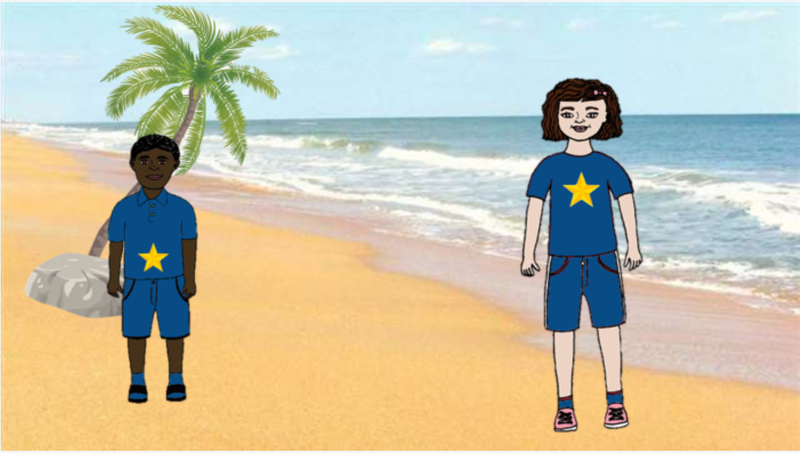
Generic
“Zarpies…”
Specific
“This Zarpie…”
Zarpies love to eat flowers.
Zarpies have striped hair on the back of their head.
This Zarpie loves to eat flowers.
This Zarpie has stripes under her hair.
n = ~50 adults (MTurk) per condition
Noyes & Keil, 2019, study 1
Notes:
Study 1
Adults
*note felicity of formal explanation as measure for kindhood!

Slide 6
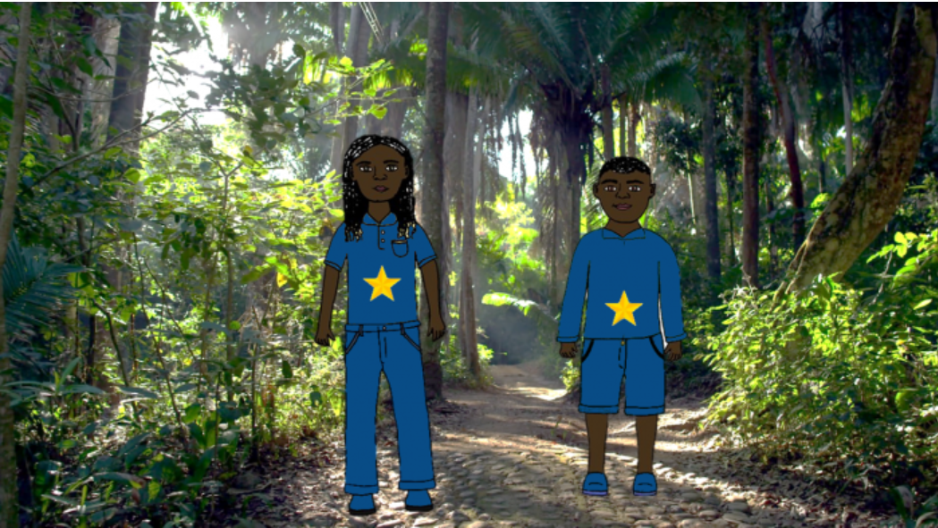
Generic
“Zarpies…”
Specific
“This Zarpie…”
Zarpies wrap their babies in orange blankets.
Zarpies sleep in tall trees.
This Zarpie wraps her baby in orange blankets.
This Zarpie sleeps in tall trees.
n = ~50 adults (MTurk) per condition
Noyes & Keil, 2019, study 1
Notes:
Study 1
Adults
*note felicity of formal explanation as measure for kindhood!

Slide 7
Generic
“Zarpies…”
Specific
“This Zarpie…”
16 properties presented in pairs with accompanying pictures of 2 Zarpies
love to eat flowers.
have striped hair on the back of their head.
can bounce a ball on their heads. like to sing.
climb tall fences.
flap their arms when they are happy.
have freckles on their feet.
hop over puddles.
hate walking in the mud.
draw stars on their knees.
can flip in the air.
are scared of ladybugs.
hate ice cream.
chase shadows.
wrap their babies in orange blankets.
sleep in tall trees.
n = ~50 adults (MTurk) per condition
Noyes & Keil, 2019, study 1
Notes:
Study 1
Adults
*note felicity of formal explanation as measure for kindhood!

Slide 8
Generic
“Zarpies…”
Specific
“This Zarpie…”
Kind
Essentialism
category is a kind:
rich causal structure, high inductive potential, shared non-accidental properties
category is a natural kind and possesses an internal essence that causally produces properties
Underneath superficial similarities and differences, all Zarpies are basically the same.
Individual Zarpies have very little in common. (reversed)
If someone tells you a fact about an individual Zarpie, that fact is very likely true of other Zarpies as well.
For some properties that Zarpies have, it makes sense to say: “This person has that property because it is a Zarpie.”
Zarpies have internal or microscopic properties that cause their characteristic appearance and behavior.
The category Zarpie was invented by people. (reversed)
The boundary between the category Zarpie and non-Zarpie is something decided by people. (reversed)
A Zarpie can never change into a non-Zarpie.
Switched-at-birth
Child measures
Noyes & Keil, 2019, study 1
Notes:
Study 1
Adults
*note felicity of formal explanation as measure for kindhood!

Slide 9
Generics tell you the category is a kind, not necessarily that the kind has an essentialist structure.
condition * measure interaction
**
*
error bars = 95% CIs
n = ~50 adults (MTurk) per condition
Noyes & Keil, 2019, study 1

Slide 10
Structural context
Generic language
“Dogs bark.”
What do generics tell us?
category is a kind:
rich causal structure, high inductive potential, shared non-accidental properties
property is non-accidentally related to category’s causal structure
Kind
How is the category structured?
Essentialism
category is a natural kind and possesses an internal essence that causally produces properties
category is situated in a stable external context (a structural context) that causally produces properties
Noyes & Keil, 2019, study 1
Notes:
Category is a kind
Property is non-accidental, related to category’s causal structure
Kinds support a diversity of causal structures
Inference to the best explanation

Slide 11
Do formal explanations work like generics?

Slide 12
Structural context
Formal explanations
“Fido barks because Fido is a dog.”
What do formal explanations tell us?
category is a kind:
rich causal structure, high inductive potential, shared non-accidental properties
property is non-accidentally related to category’s causal structure
Kind
How is the category structured?
Essentialism
category is a natural kind and possesses an internal essence that causally produces properties
category is situated in a stable external context (a structural context) that causally produces properties
Notes:
Same thing w formal explanations?

Slide 13
I am going to tell you about an island far away. On this island, there live lots of different people. I am going to tell you about one group of people on the island: Zarpies! Let's meet some Zarpies.
n = 150 adults (MTurk)
Notes:
Study 1
Adults
*note felicity of formal explanation as measure for kindhood!

Slide 14
Formal explanation
Generic
Specific
“She… because she’s a Zarpie”
“Zarpies…”
“This Zarpie…”
He loves to eat flowers because he’s a Zarpie.
She has striped hair on the back of her head because she’s a Zarpie.
This Zarpie loves to eat flowers.
This Zarpie has stripes under her hair.
n = ~50 adults (MTurk) per condition
Notes:
Study 1
Adults
*note felicity of formal explanation as measure for kindhood!

Slide 15
Formal explanation
Generic
Specific
“She… because she’s a Zarpie”
“Zarpies…”
“This Zarpie…”
She wraps her baby in orange blankets because she’s a Zarpie.
He sleeps in tall trees because he’s a Zarpie.
This Zarpie wraps her baby in orange blankets.
This Zarpie sleeps in tall trees.
n = ~50 adults (MTurk) per condition
Notes:
Study 1
Adults
*note felicity of formal explanation as measure for kindhood!

Slide 16
Formal explanation
Generic
Specific
“She… because she’s a Zarpie”
“Zarpies…”
“This Zarpie…”
16 properties presented in pairs with accompanying pictures of 2 Zarpies
love to eat flowers.
have striped hair on the back of their head.
can bounce a ball on their heads. like to sing.
climb tall fences.
flap their arms when they are happy.
have freckles on their feet.
hop over puddles.
hate walking in the mud.
draw stars on their knees.
can flip in the air.
are scared of ladybugs.
hate ice cream.
chase shadows.
wrap their babies in orange blankets.
sleep in tall trees.
n = ~50 adults (MTurk) per condition
Noyes & Keil, 2019, study 1
Notes:
Study 1
Adults
*note felicity of formal explanation as measure for kindhood!

Slide 17
Formal explanation
Generic
Specific
“She… because she’s a Zarpie”
“Zarpies…”
“This Zarpie…”
Kind
Essentialism
category is a kind:
rich causal structure, high inductive potential, shared non-accidental properties
category is a natural kind and possesses an internal essence that causally produces properties
Underneath superficial similarities and differences, all Zarpies are basically the same.
Individual Zarpies have very little in common. (reversed)
If someone tells you a fact about an individual Zarpie, that fact is very likely true of other Zarpies as well.
For some properties that Zarpies have, it makes sense to say: “This person has that property because it is a Zarpie.”
Zarpies have internal or microscopic properties that cause their characteristic appearance and behavior.
The category Zarpie was invented by people. (reversed)
The boundary between the category Zarpie and non-Zarpie is something decided by people. (reversed)
A Zarpie can never change into a non-Zarpie.
n = ~50 adults (MTurk) per condition
Noyes & Keil, 2019
Notes:
Study 1
Adults
*note felicity of formal explanation as measure for kindhood!
Control:
“This Zarpie sleeps in tall trees”
Preamble: Let’s learn some things about her: She’s a Zarpie. She sleeps in tall trees.”
“She’s a Zarpie, and sleeps in tall trees.”

Slide 18
Generics tell you the category is a kind, not necessarily that the kind has an essentialist structure.
condition * measure interaction
**
*
error bars = 95% CIs
n = ~50 adults (MTurk) per condition
Noyes & Keil, 2019, study 1
Notes:
Reminder

Slide 19
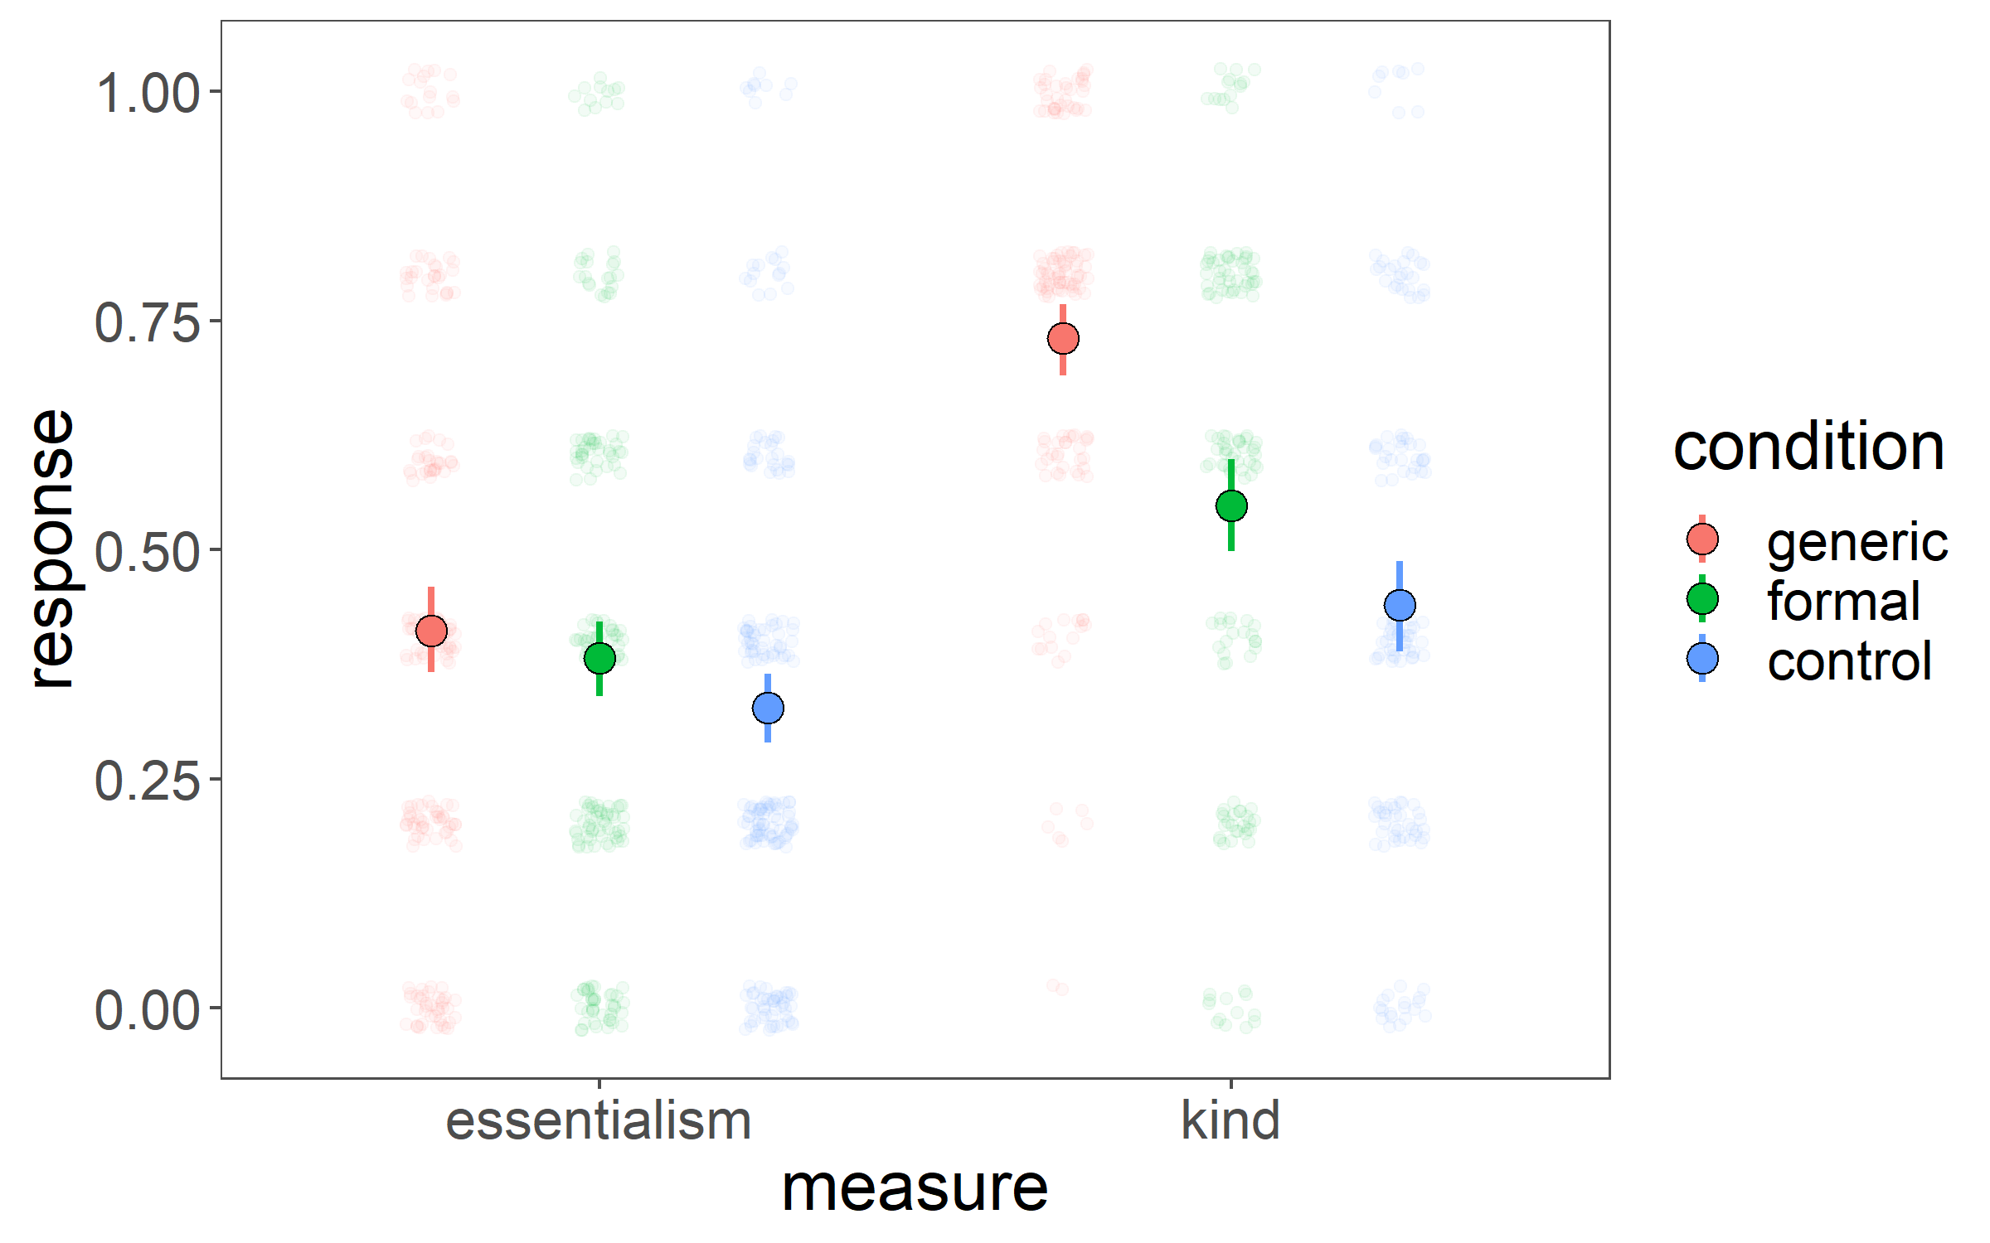
Generics tell you the category is a kind, not necessarily that the kind has an essentialist structure.
Noyes & Keil, 2019: study 1
our study
condition * measure interaction
condition * measure interaction
**
**
*
*
error bars = 95% CIs
replicated the generics findings!
n = ~50 adults (MTurk) per condition
Notes:
Replicate generics

Slide 20
Formal explanations...
error bars = 95% CIs
n = ~50 adults (MTurk) per condition
Notes:
What about formal explanations

Slide 21
Formal explanations…
*
p=0.12
error bars = 95% CIs
n = ~50 adults (MTurk) per condition
Notes:
Formal explanations increase kind, but not essentialism

Slide 22
Formal explanations…
condition * measure (p=0.18)
*
p=0.12
error bars = 95% CIs
n = ~50 adults (MTurk) per condition
Notes:
If we just consider the planned formal vs control contrast, unfortunately there’s no interaction of measure and condition

Slide 23
Formal explanations tell you the category is a kind, not necessarily that the kind has an essentialist structure?
condition * measure (p=0.18)
*
p=0.12
error bars = 95% CIs
n = ~50 adults (MTurk) per condition
Notes:
Formal explanations increase kind, but not essentialism

Slide 24
Noyes & Keil, 2019: study 1
our study
condition * measure interaction
**
**
*
*
*
p=0.12
error bars = 95% CIs
n = ~50 adults (MTurk) per condition
Notes:
Full comparison

Slide 26
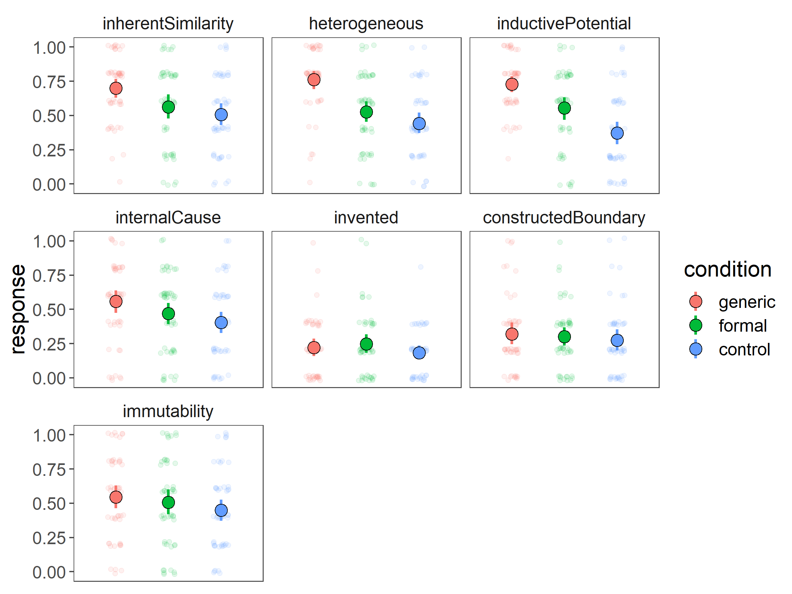
Kind
Essentialism
n = ~50 adults (MTurk) per condition

